Slide 1

CSE-214: Numerical Methods Sessional
Md. Jakaria
Lecturer
Dept. of CSE, MIST

Slide 2
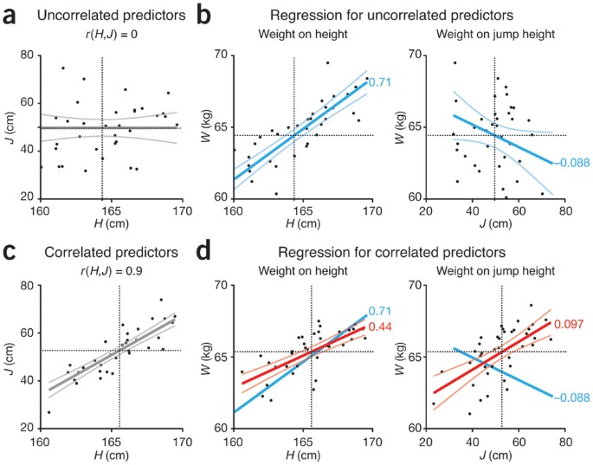
Linear Regression
CSE 214: Numerical Methods Sessional
2

Slide 3



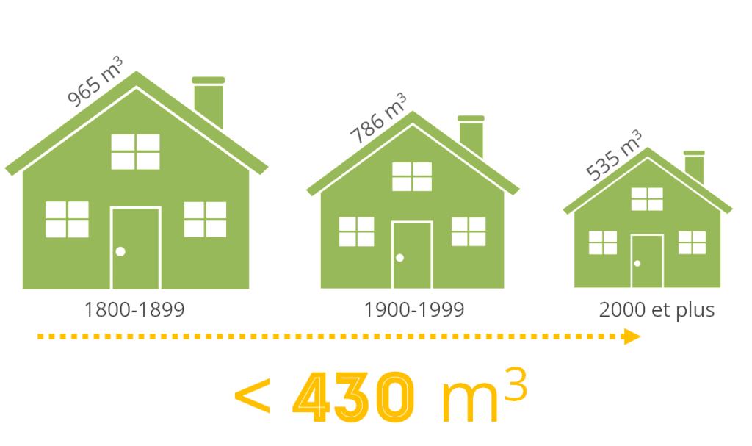

Motivation
Rooms
Size
House
Location
Calculate Price
CSE 214: Numerical Methods Sessional

Slide 4
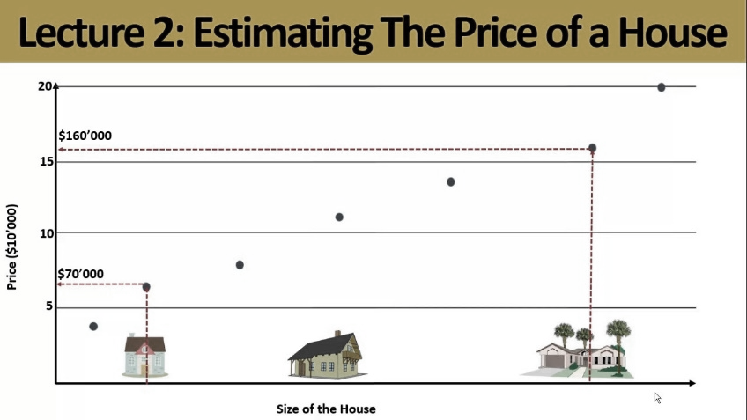
Motivation
Plotting price based on size of the house
CSE 214: Numerical Methods Sessional

Slide 5
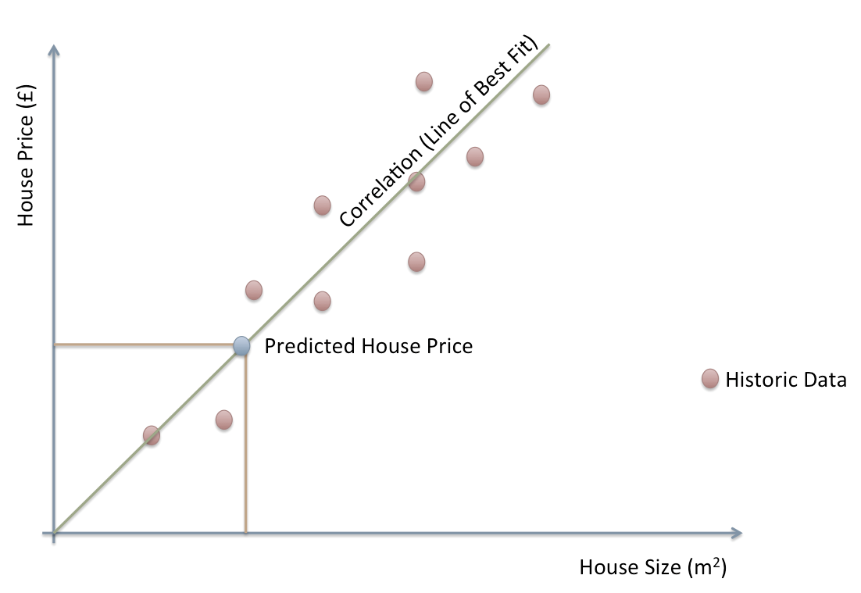
Motivation
Prediction line to estimate price
CSE 214: Numerical Methods Sessional

Slide 6
Introduction
Regression is a numerical method used to predict the relationship between independent and dependent variables.
Uses
Trend forecasting
Forecasting the effect of a variable
Determining the strength for predictors
CSE 214: Numerical Methods Sessional

Slide 7
Introduction
Regression is a numerical method used to predict the relationship between independent and dependent variables.
Regression
Simple Linear Regression
Multiple Linear Regression
Polynomial Regression
CSE 214: Numerical Methods Sessional

Slide 8
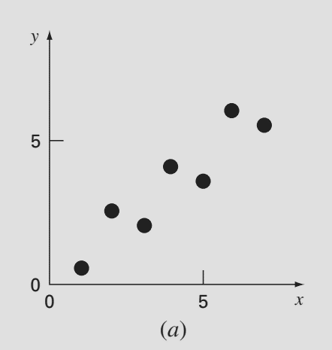
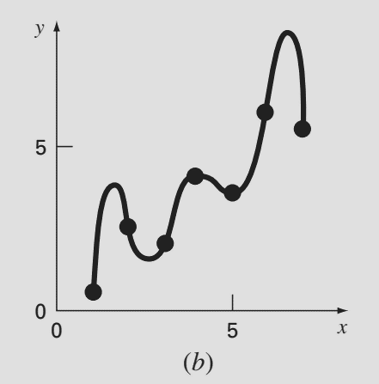
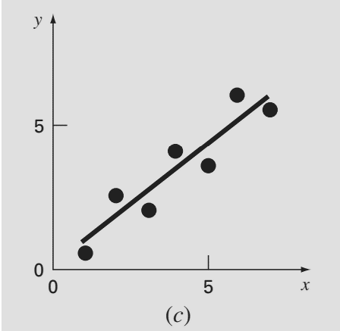
Simple Linear Regression
The simplest example of a regression is fitting a straight line to a set of paired observations (x₁, y₁), (x₂, y₂), . . . , (x_{n}, y_{n}).
CSE 214: Numerical Methods Sessional

Slide 9
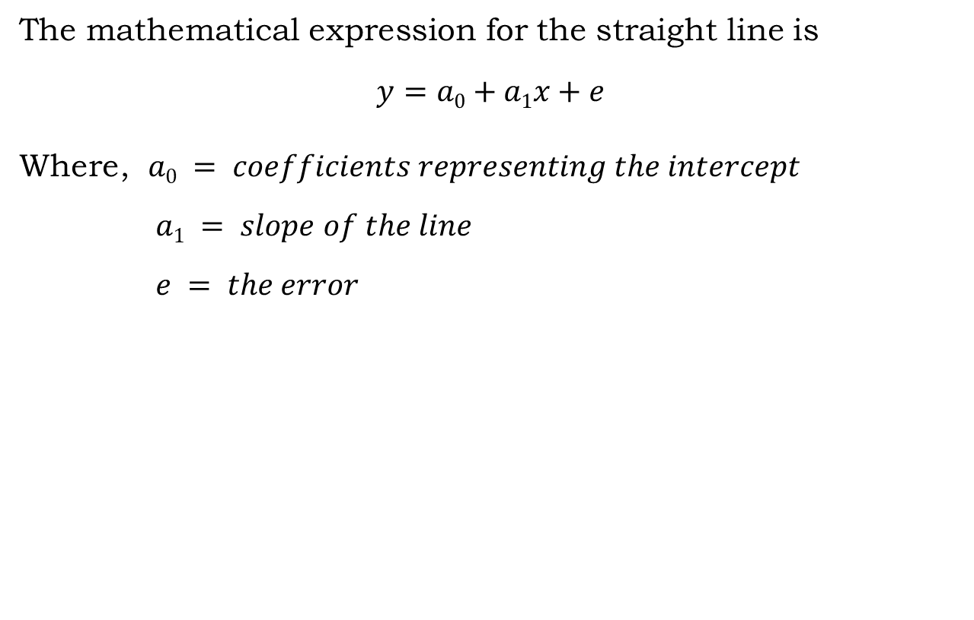
Simple Linear Regression
The mathematical expression for the straight line is
$$y=a0+a1x+e$$
Where, $a0 = coefficients representing the intercept$
$a1 = slope of the line$
$e = the error$
CSE 214: Numerical Methods Sessional

Slide 10
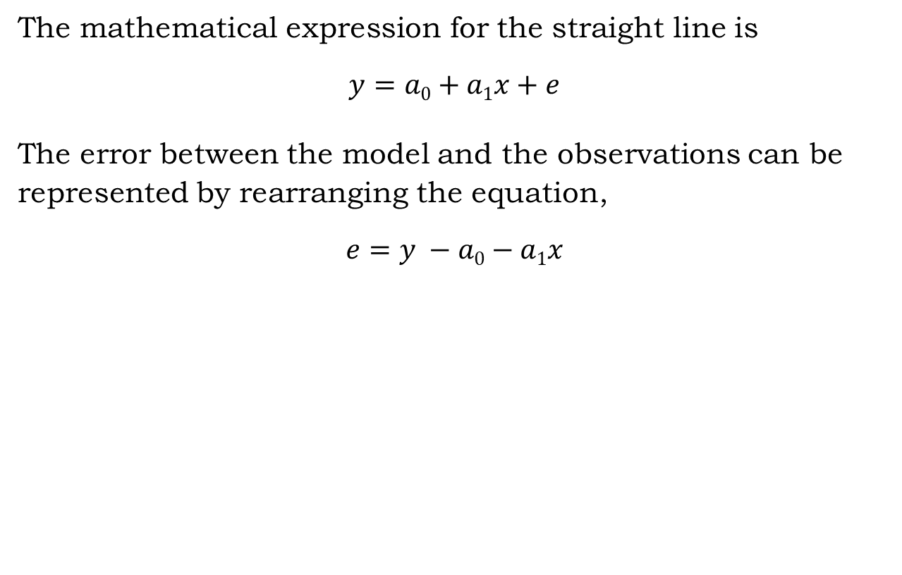
Simple Linear Regression
The mathematical expression for the straight line is
$$y=a0+a1x+e$$
The error between the model and the observations can be represented by rearranging the equation,
$$e=y −a0−a1x$$
CSE 214: Numerical Methods Sessional

Slide 11
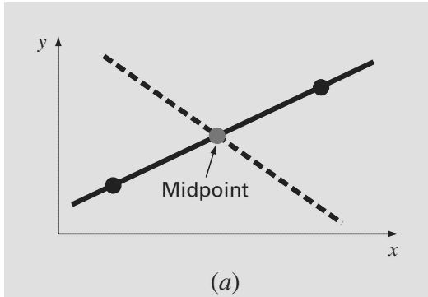
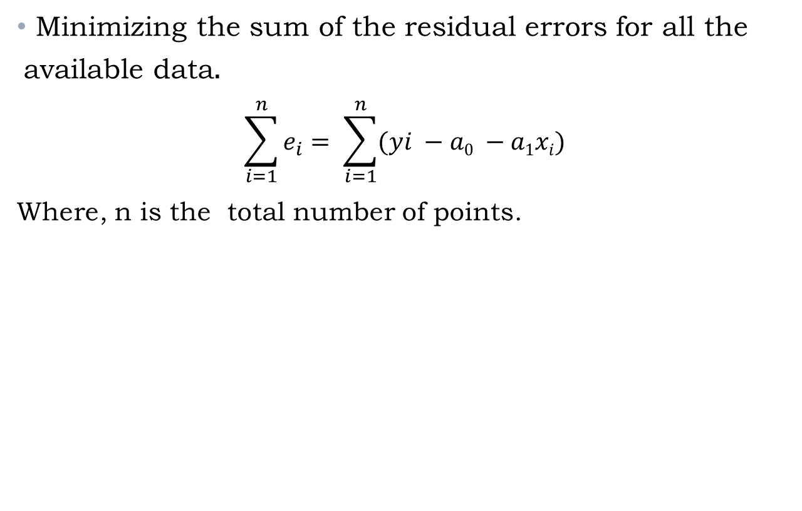
Criteria for a “Best” Fit
Minimizing the sum of the residual errors for all the available data$.$
$$\sum_{i=1}^{n}{e_{i}= \sum_{i=1}^{n}{(yi −a0 −a1xi)}}$$
Where, n is the total number of points.
CSE 214: Numerical Methods Sessional

Slide 12
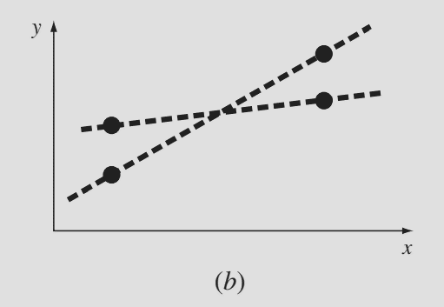

Criteria for a “Best” Fit
Minimizing the sum of the absolute values of the discrepancies$.$
$$\sum_{i=1}^{n}{{|e}_{i}|= \sum_{i=1}^{n}{|yi −a0 −a1xi|}}$$
Where, n is the total number of points.
CSE 214: Numerical Methods Sessional

Slide 13
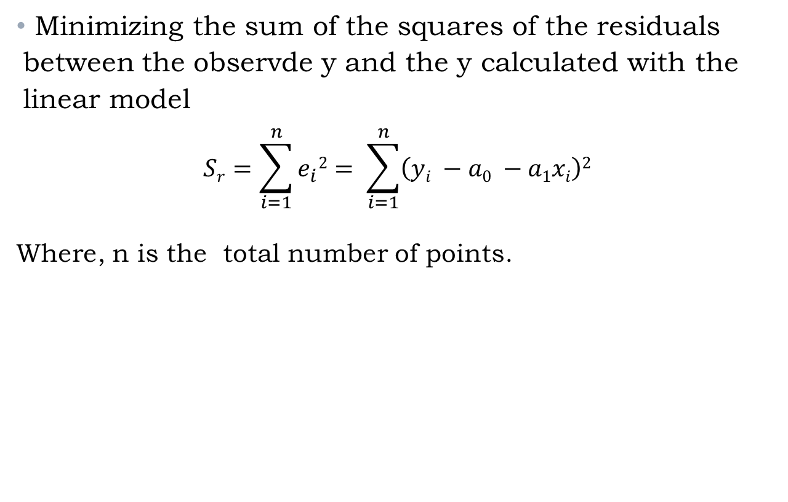
Criteria for a “Best” Fit
Minimizing the sum of the squares of the residuals between the observde y and the y calculated with the linear model
$$Sr=\sum_{i=1}^{n}{e_{i}2= \sum_{i=1}^{n}{\left(yi −a0 −a1xi\right)2}}$$
Where, n is the total number of points.
CSE 214: Numerical Methods Sessional

Slide 14
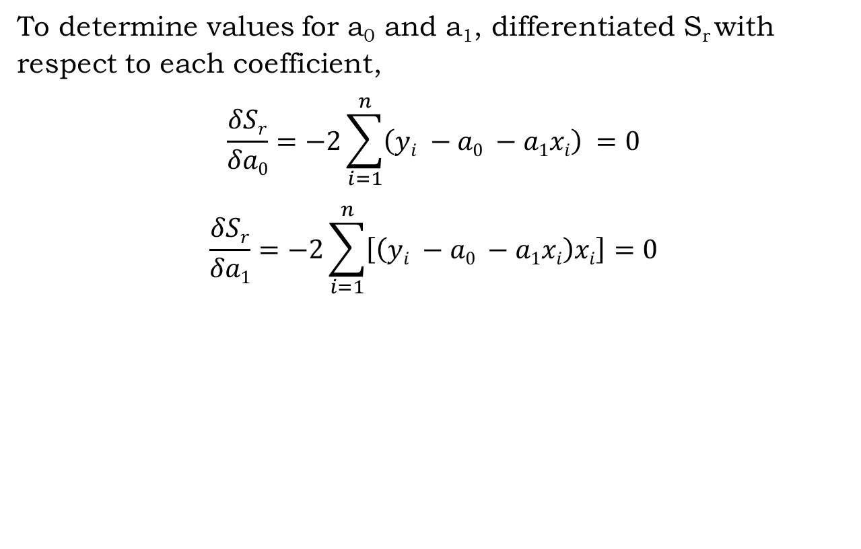
Least-Squares Fit
To determine values for a₀ and a₁, differentiated S_{r} with respect to each coefficient,
$$\frac{δSr}{δa0}=−2\sum_{i=1}^{n}{\left(yi −a0 −a1xi\right)} =0$$
$$\frac{δSr}{δa1}=−2\sum_{i=1}^{n}{\left[\left(yi −a0 −a1xi\right)xi\right]}=0$$
CSE 214: Numerical Methods Sessional

Slide 15
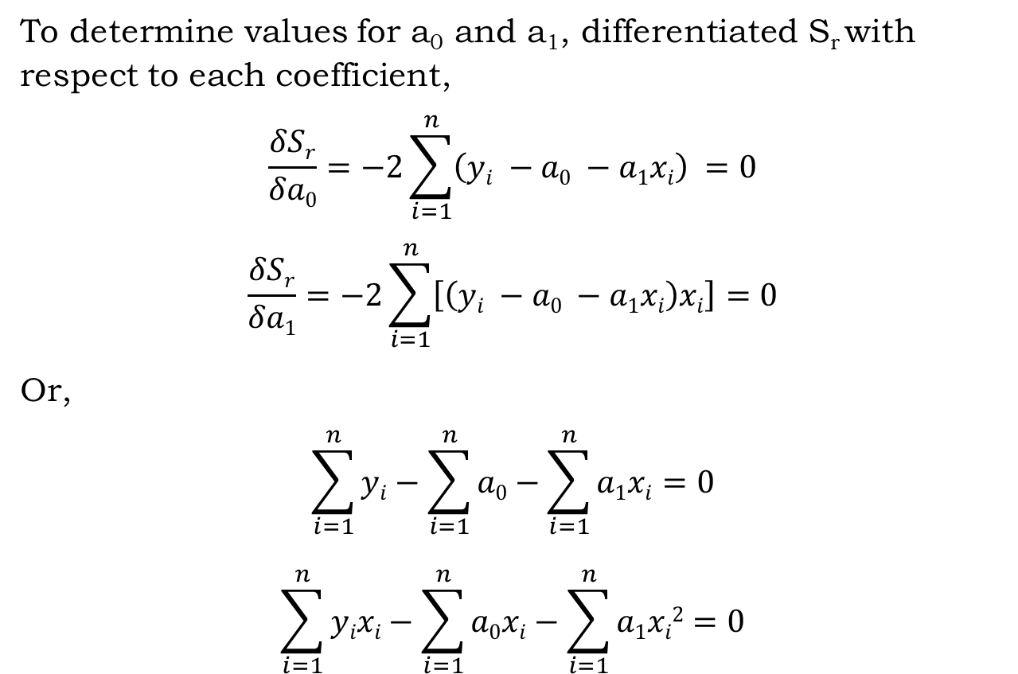
Least-Squares Fit
To determine values for a₀ and a₁, differentiated S_{r} with respect to each coefficient,
$$\frac{δSr}{δa0}=−2\sum_{i=1}^{n}{\left(yi −a0 −a1xi\right)} =0$$
$$\frac{δSr}{δa1}=−2\sum_{i=1}^{n}{\left[\left(yi −a0 −a1xi\right)xi\right]}=0$$
Or,
$$\sum_{i=1}^{n}{yi}−\sum_{i=1}^{n}{a0}−\sum_{i=1}^{n}{a1xi}=0$$
$$\sum_{i=1}^{n}{yixi}−\sum_{i=1}^{n}{a0xi}−\sum_{i=1}^{n}{a1xi2}=0$$
CSE 214: Numerical Methods Sessional

Slide 16
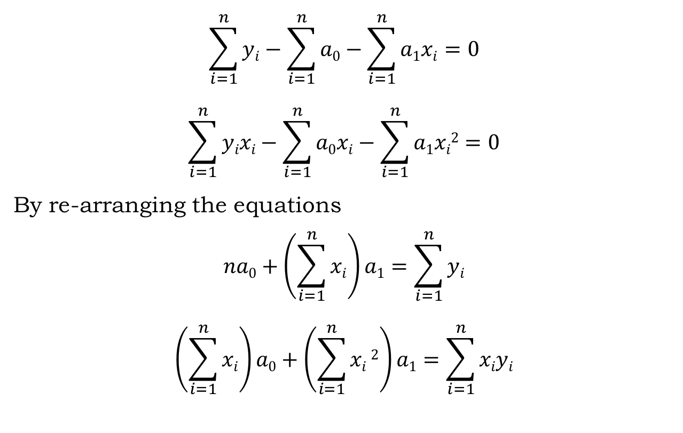
Least-Squares Fit
$$\sum_{i=1}^{n}{yi}−\sum_{i=1}^{n}{a0}−\sum_{i=1}^{n}{a1xi}=0$$
$$\sum_{i=1}^{n}{yixi}−\sum_{i=1}^{n}{a0xi}−\sum_{i=1}^{n}{a1xi2}=0$$
By re-arranging the equations
$$na0+\left(\sum_{i=1}^{n}{xi}\right)a1=\sum_{i=1}^{n}{yi}$$
$$\left(\sum_{i=1}^{n}{xi}\right)a0+\left(\sum_{i=1}^{n}{xi}2\right)a1=\sum_{i=1}^{n}{xiyi}$$
CSE 214: Numerical Methods Sessional

Slide 17
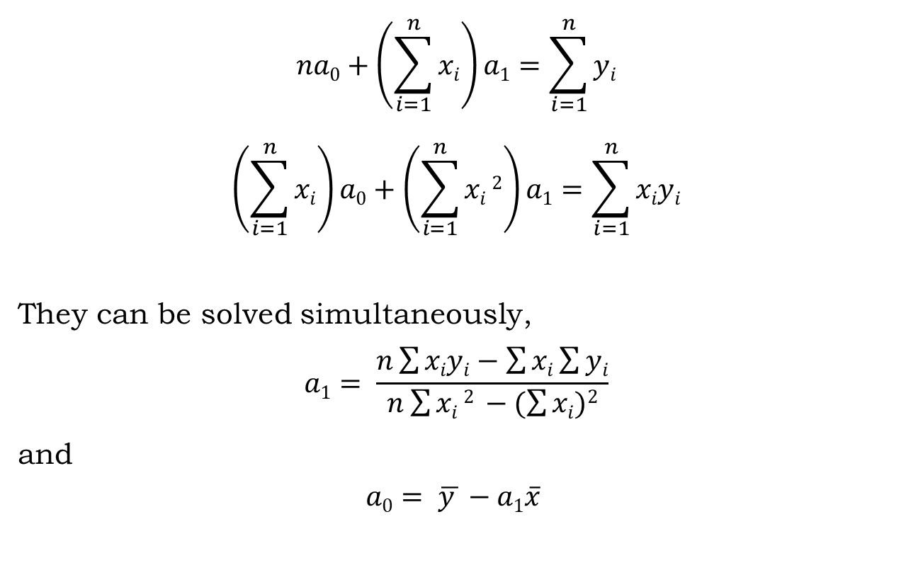
Least-Squares Fit
$$na0+\left(\sum_{i=1}^{n}{xi}\right)a1=\sum_{i=1}^{n}{yi}$$
$$\left(\sum_{i=1}^{n}{xi}\right)a0+\left(\sum_{i=1}^{n}{xi}2\right)a1=\sum_{i=1}^{n}{xiyi}$$
They can be solved simultaneously,
$$a1= \frac{n\sum{xiyi}−\sum{xi}\sum{yi}}{n\sum{xi}2 −(\sum{xi})2}$$
and
$$a0= \overline{y }−a1\overline{x}$$
CSE 214: Numerical Methods Sessional

Slide 18
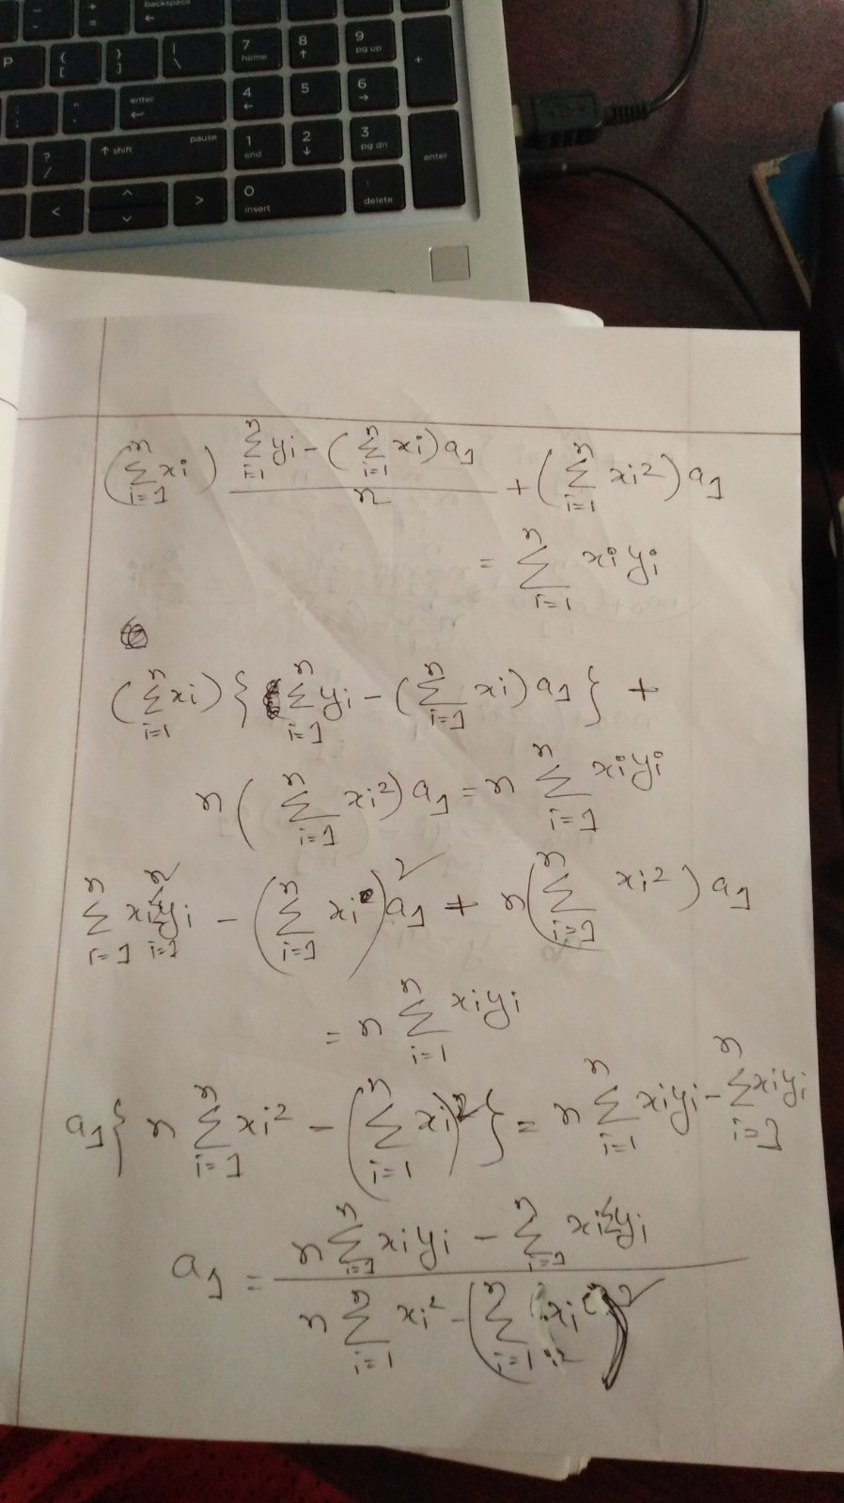
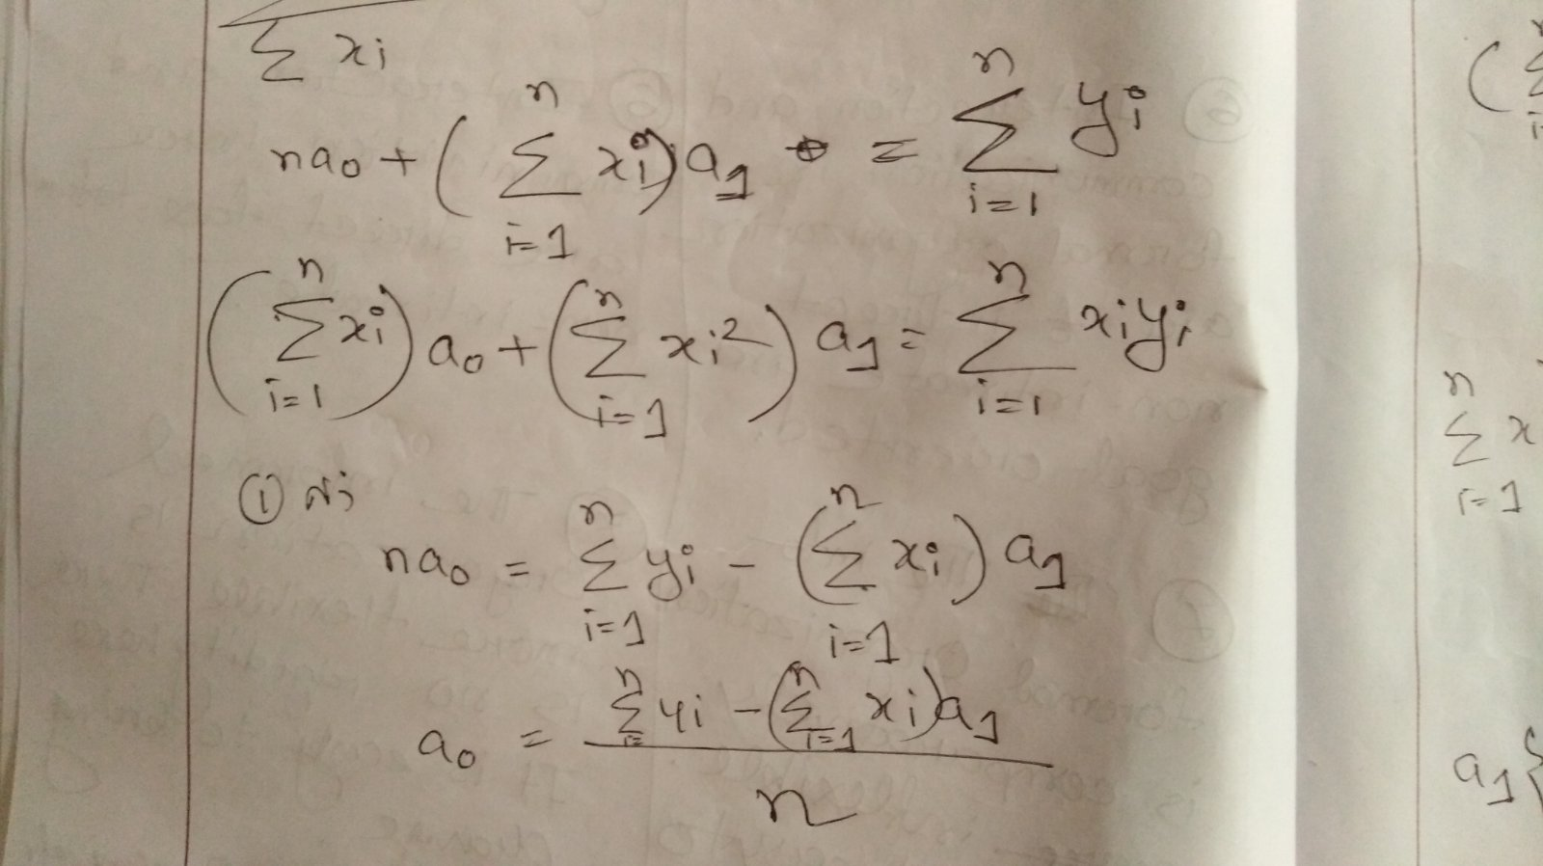

Slide 19
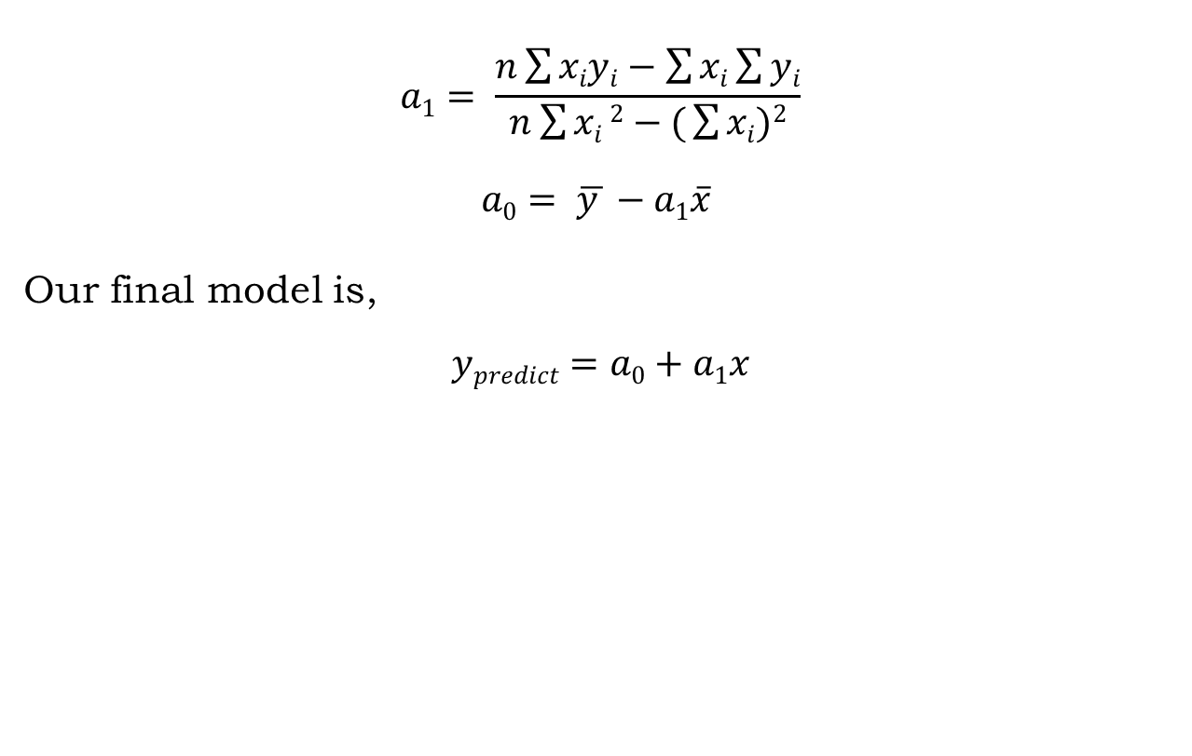
Least-Squares Fit
$$a1= \frac{n\sum{xiyi}−\sum{xi}\sum{yi}}{n\sum{xi}2−( \sum{xi})2}$$
$$a0= \overline{y }−a1\overline{x}$$
Our final model is,
$$ypredict=a0+a1x$$
CSE 214: Numerical Methods Sessional

Slide 20
Goodness of Fit: R-Square
R-squared value is a statistical measure of how close the data are to the fitted regression line
It is also known as coefficient of determination, or the coefficient of multiple determination
CSE 214: Numerical Methods Sessional

Slide 21
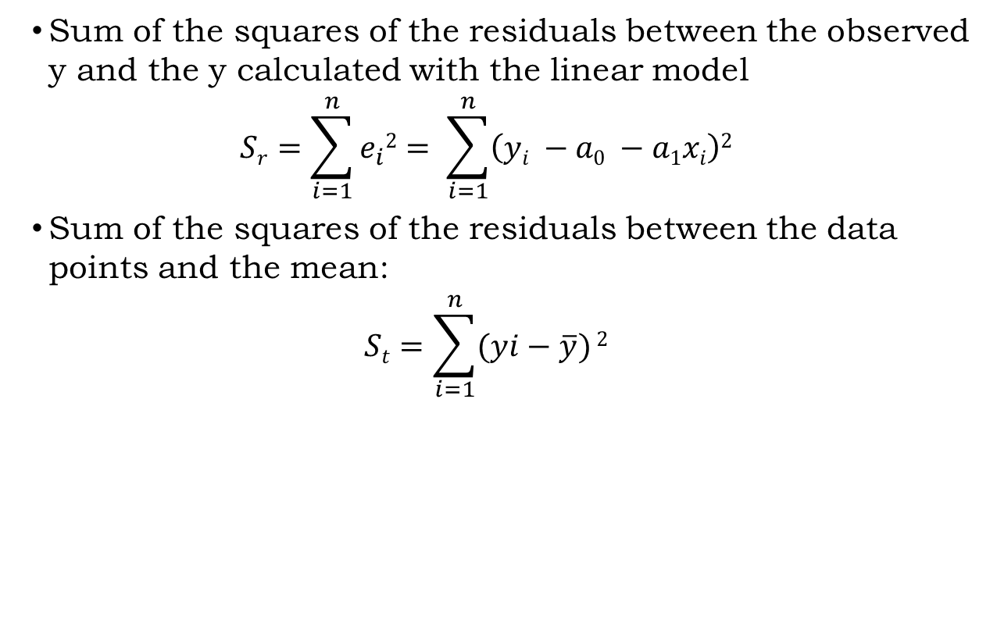
Goodness of Fit: R-Square
Sum of the squares of the residuals between the observed y and the y calculated with the linear model
$$Sr=\sum_{i=1}^{n}{e_{i}2= \sum_{i=1}^{n}{\left(yi −a0 −a1xi\right)2}}$$
Sum of the squares of the residuals between the data points and the mean:
$$St=\sum_{i=1}^{n}{(yi−\overline{y})}2$$
CSE 214: Numerical Methods Sessional

Slide 22
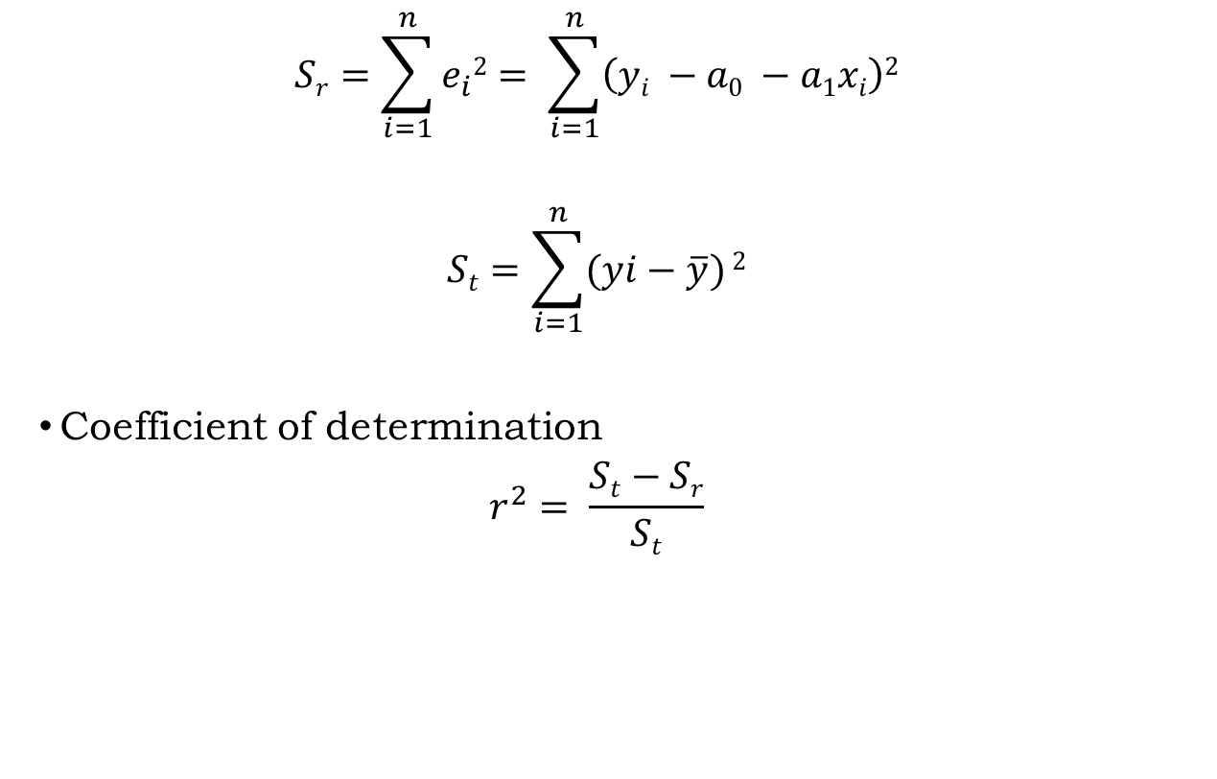
Goodness of Fit: R-Square
$$Sr=\sum_{i=1}^{n}{e_{i}2= \sum_{i=1}^{n}{\left(yi −a0 −a1xi\right)2}}$$
$$St=\sum_{i=1}^{n}{(yi−\overline{y})}2$$
Coefficient of determination
$$r^{2}= \frac{St−Sr}{St}$$
CSE 214: Numerical Methods Sessional

Slide 23
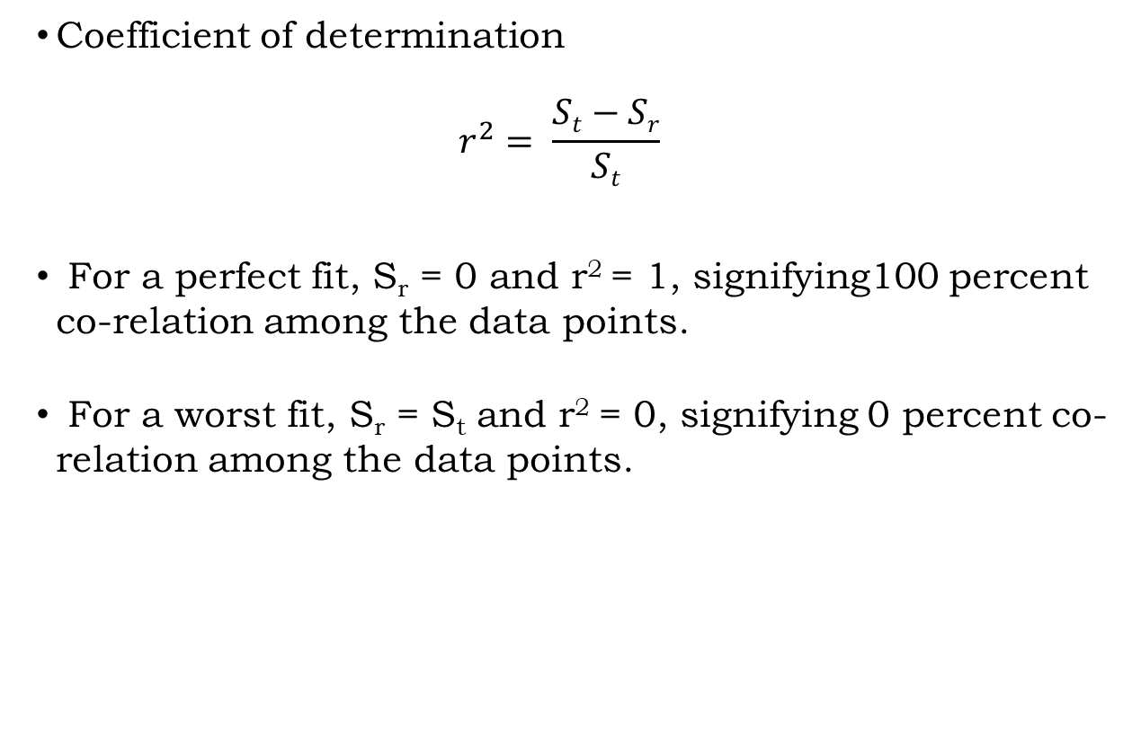
Goodness of Fit: R-Square
Coefficient of determination
$$r^{2}= \frac{St−Sr}{St}$$
For a perfect fit, S_{r} = 0 and r² = 1, signifying100 percent co-relation among the data points.
For a worst fit, S_{r} = S_{t} and r² = 0, signifying 0 percent co-relation among the data points.
CSE 214: Numerical Methods Sessional

Slide 24
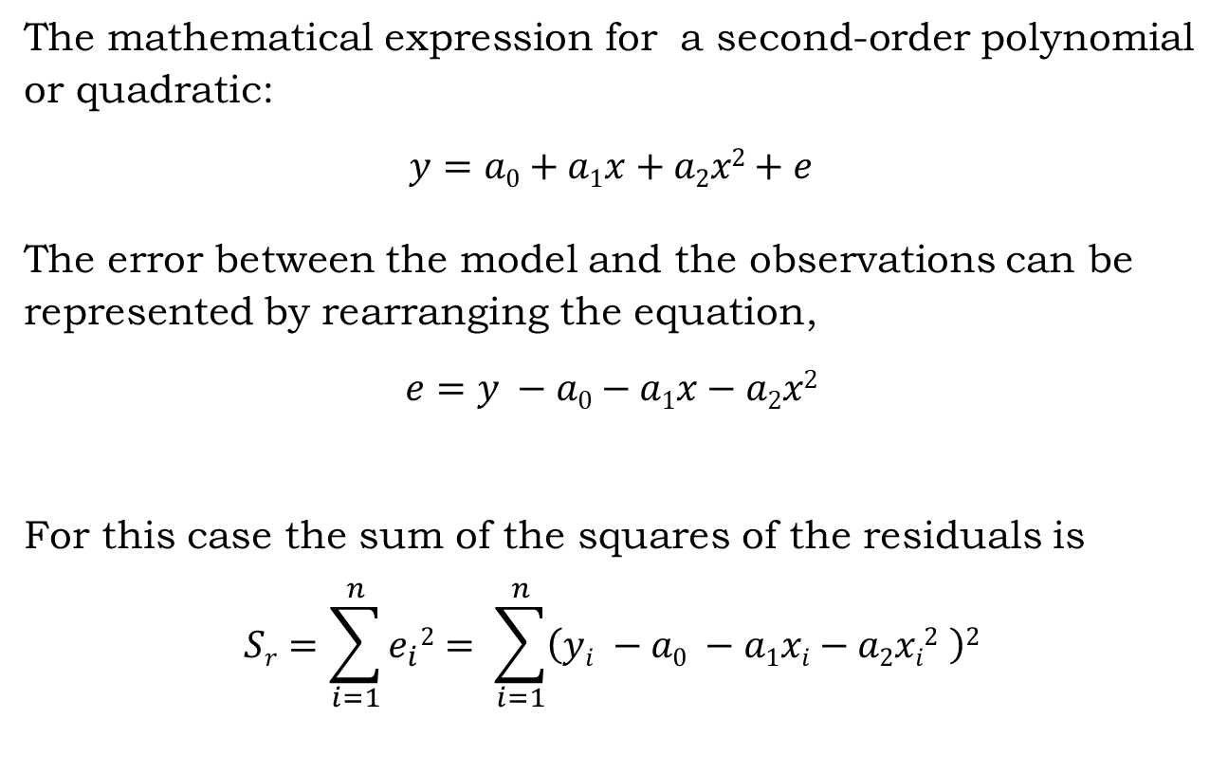
Polynomial Regression
The mathematical expression for a second-order polynomial or quadratic:
$$y=a0+a1x+a2x2+e$$
The error between the model and the observations can be represented by rearranging the equation,
$$e=y −a0−a1x−a2x2$$
For this case the sum of the squares of the residuals is
$$Sr=\sum_{i=1}^{n}{e_{i}2= \sum_{i=1}^{n}{\left(yi −a0 −a1xi−a2xi2 \right)2}}$$
CSE 214: Numerical Methods Sessional

Slide 25
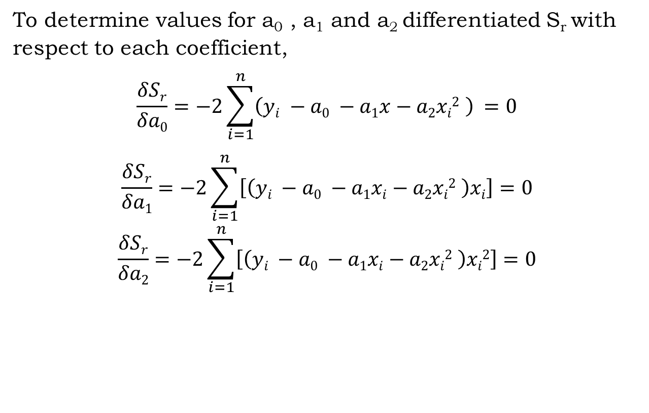
Least-Squares Fit
To determine values for a₀ , a₁ and a₂ differentiated S_{r} with respect to each coefficient,
$$\frac{δSr}{δa0}=−2\sum_{i=1}^{n}{\left(yi −a0 −a1x−a2xi2 \right)} =0$$
$$\frac{δSr}{δa1}=−2\sum_{i=1}^{n}{\left[\left(yi −a0 −a1xi−a2xi2 \right)xi\right]}=0$$
$$\frac{δSr}{δa2}=−2\sum_{i=1}^{n}{\left[\left(yi −a0 −a1xi−a2xi2 \right)xi2\right]}=0$$
CSE 214: Numerical Methods Sessional

Slide 26
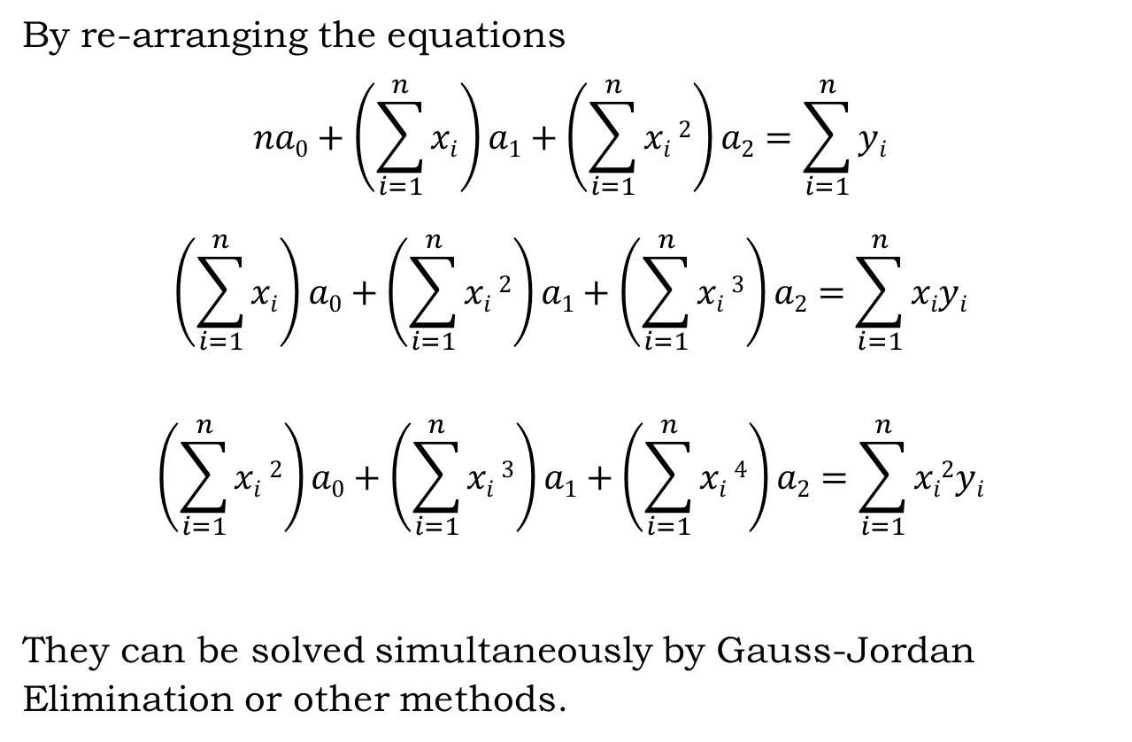
Least-Squares Fit
By re-arranging the equations
$$na0+\left(\sum_{i=1}^{n}{xi}\right)a1+\left(\sum_{i=1}^{n}{xi}2\right)a2=\sum_{i=1}^{n}{yi}$$
$$\left(\sum_{i=1}^{n}{xi}\right)a0+\left(\sum_{i=1}^{n}{xi}2\right)a1+\left(\sum_{i=1}^{n}{xi}3\right)a2=\sum_{i=1}^{n}{xiyi}$$
$$\left(\sum_{i=1}^{n}{xi}2\right)a0+\left(\sum_{i=1}^{n}{xi}3\right)a1+\left(\sum_{i=1}^{n}{xi}4\right)a2=\sum_{i=1}^{n}{xi2yi}$$
They can be solved simultaneously by Gauss-Jordan Elimination or other methods.
CSE 214: Numerical Methods Sessional

Slide 27
Acknowledgement & References
Acknowledgement
Sincere thanks go to Steven C. Chapra and Raymond P. Canale
- for their Numerical Methods for Engineers book.
And Lec Anindita Kundu
for her slides.
References
Numerical Methods for Engineers (7th ed.) - by Chapra and Canale
Chapter 17: Least Square Regression
17.1 Linear Regression
17.2 Polynomial Regression
17.3 Multiple Linear Regression
CSE 214: Numerical Methods Sessional

